Slide 1
PSTU Enrollment Automation System Using Django Framework and SQLite
Developed by
Md. Tasnif Rahman [1802014]
Mehedi Hasan Rabbi [1802052]
Supervised by
Golam Md. Muradul Bashir
Professor
Department of Computer and Communication Engineering
Faculty of Computer Science & Engineering
Patuakhali Science & Technology University

Slide 2



Introduction
This presentation outlines the development of the PSTU Enrollment System
Python Framework
Communication Optimization
Web Development Tools
The system is built on the Django framework with Python, providing robust functionality.
Utilizes HTML, CSS, and JavaScript to enhance the system's capabilities.
Focuses on optimizing administrative processes and communication in educational institutions.

Slide 3



Problem
Inefficiency and Errors
Lack of Centralization
Robust Management System Needed
Manual enrollment systems are prone to inefficiencies and errors.
There is no centralized platform for administrative tasks and communication.
There is a need for a robust university management system.

Slide 4
Proposed Solution
1
PSTU Enrollment System
The enrollment system will be specifically designed for PSTU, catering to its unique requirements.
2
User-friendly interfaces for students and administrators
The interfaces will be intuitive, making it easy for both students and administrators to navigate and use the system.
3
Comprehensive enrollment module
The system will include a comprehensive module covering all aspects of the enrollment process, ensuring efficiency and accuracy.
4
Integrated payment gateways
Secure and seamless integration of payment gateways for easy and reliable transactions within the system.
5
Responsive design
The system will be designed to be responsive, ensuring a seamless experience across devices and screen sizes.

Slide 5
Technical Details
Frontend: HTML, CSS, Bootstrap
Framework: Django (MVC architecture)
Database Management System: Django ORM, SQLite
Backend: JavaScript
Integrates JavaScript for dynamic and interactive user experiences, enhancing the system's functionality.
Utilizes a combination of HTML, CSS, and Bootstrap for a modern and visually appealing user interface.
Utilizes Django's MVC architecture for clear separation of concerns, promoting scalability and maintainability.
Employs the Django ORM to reduce security vulnerabilities and ensures efficient data management using SQLite.

Slide 6




Objectives
Full Automation of Student Enrollment
Enhanced User Authentication Mechanisms
Optimized Database Structure and Query Performance
Implement a seamless, end-to-end automated process for student enrollment.
Strengthen user authentication with advanced mechanisms for security and access control.
Refine database structure and enhance query performance for efficient data management.

Slide 7
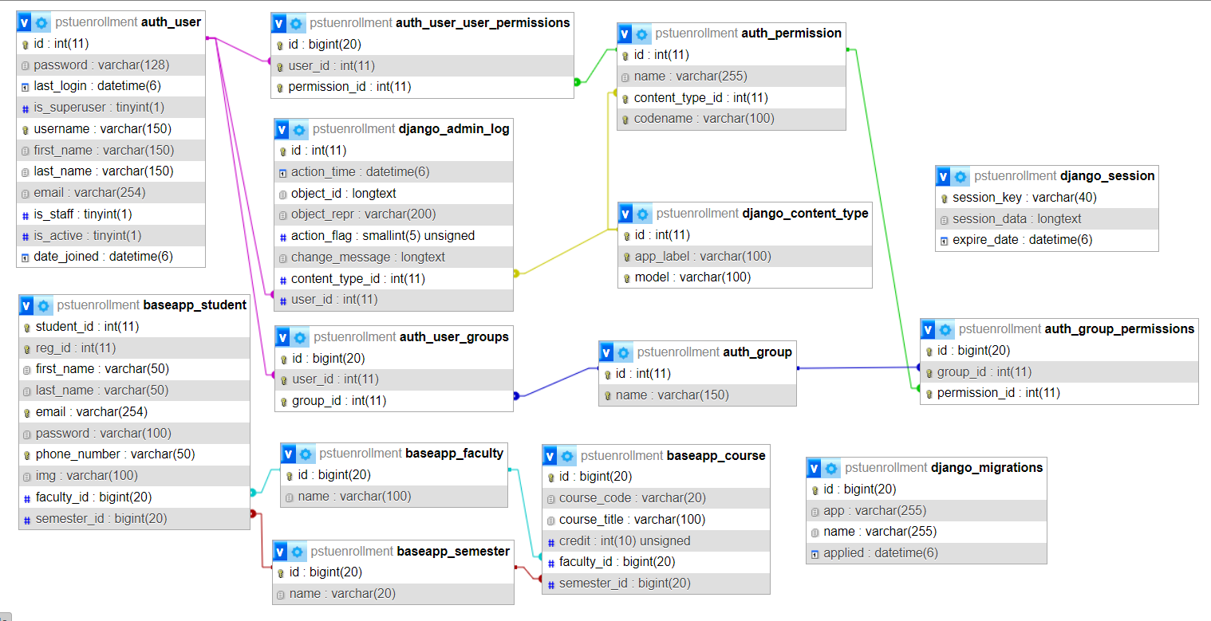
Database Design
Database design is critical for the efficient management of data within the PSTU Enrollment System. The structured organization of data entities and their relationships ensures optimal performance, scalability, and data integrity throughout the system's lifecycle.

Slide 8

Software Design
1
Admin Panel
The admin panel is a crucial component for system management and oversight.
2
Student Account Management
Efficient student account management ensures personalized and seamless user experience.
3
Course Management and Payment Page Design
These components are pivotal for the functionality, usability, and security of the system.

Slide 9
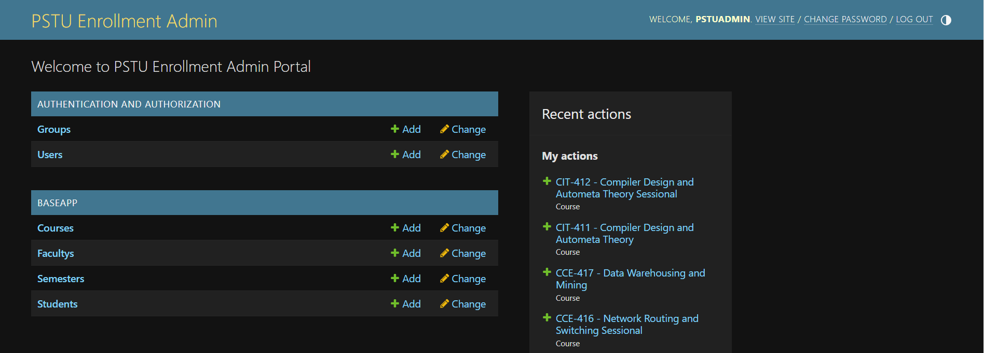
Admin Panel

Slide 10
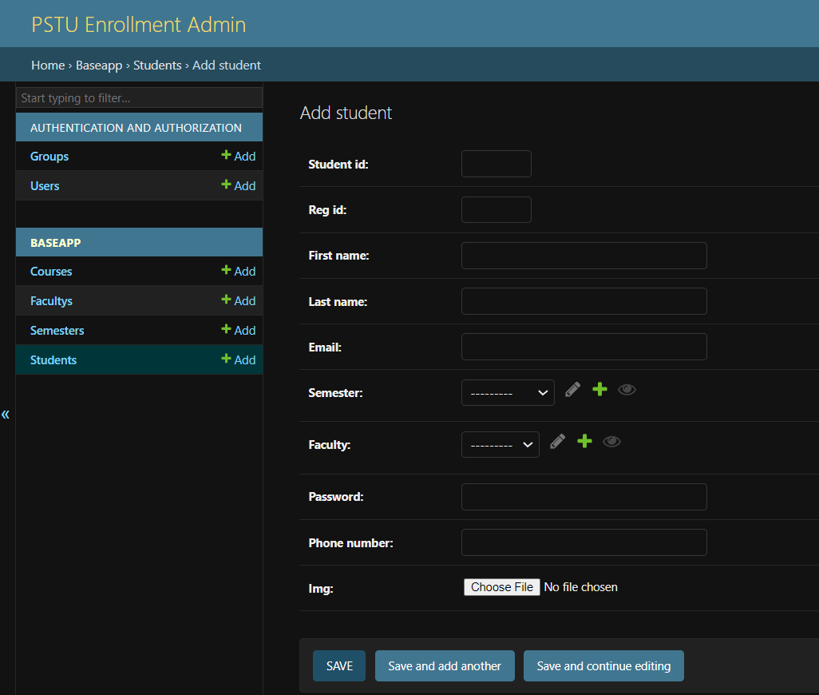
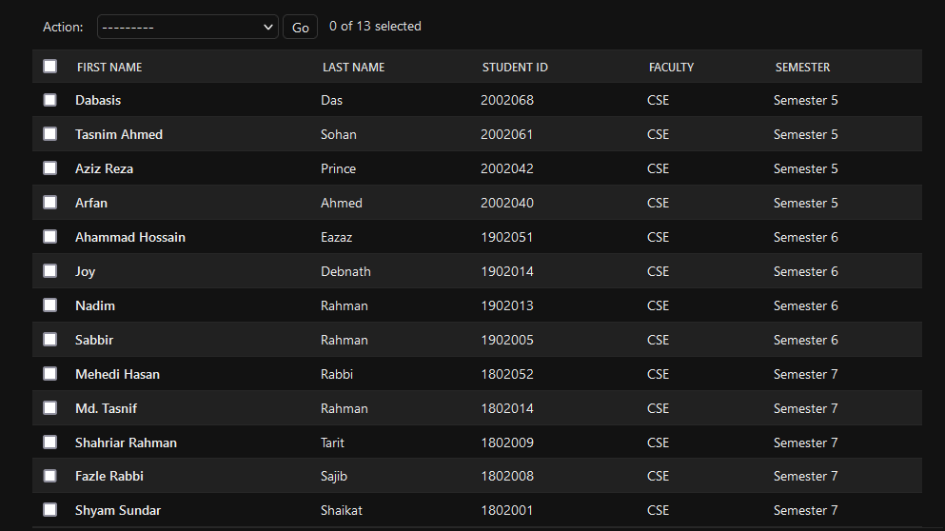
Student Account Create and Delete

Slide 11
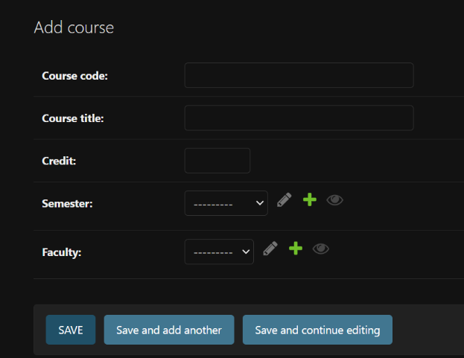
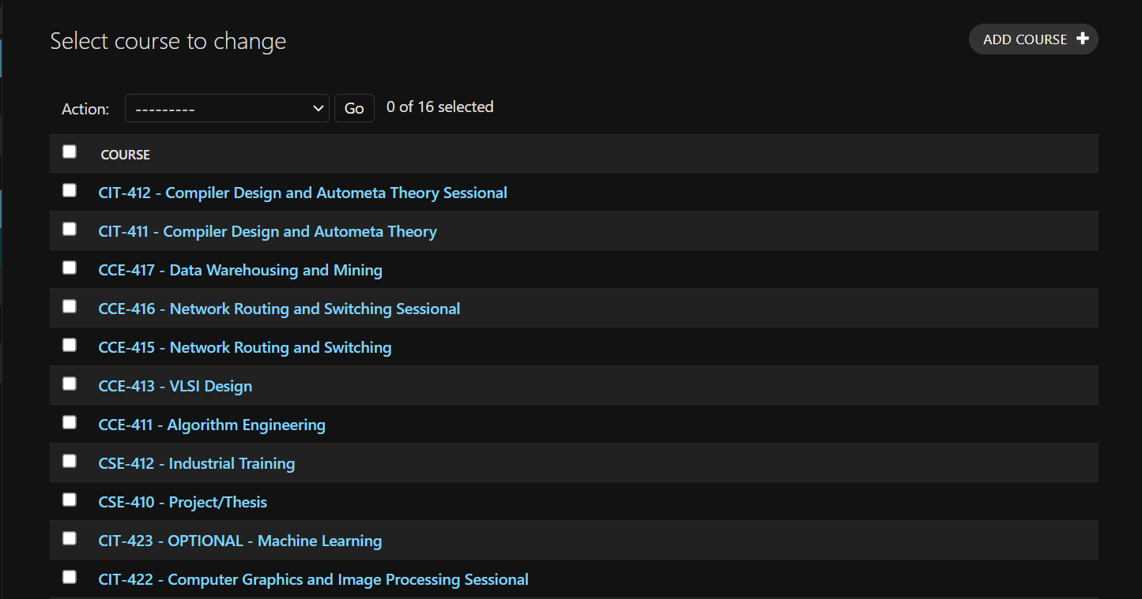
Course Add and Delete

Slide 12
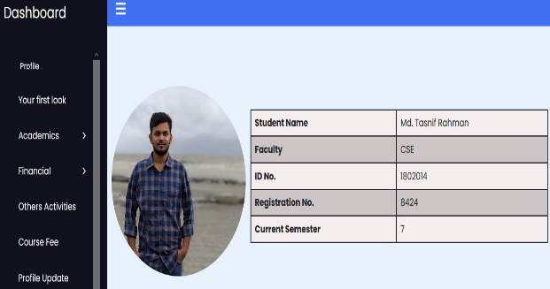
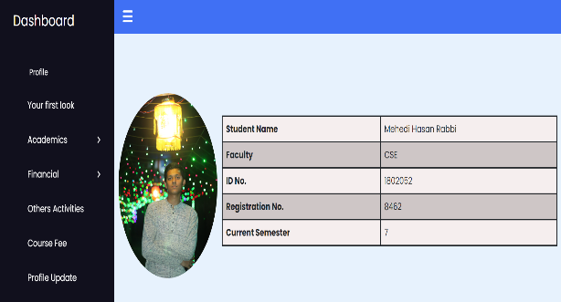
Student Dashboard

Slide 13
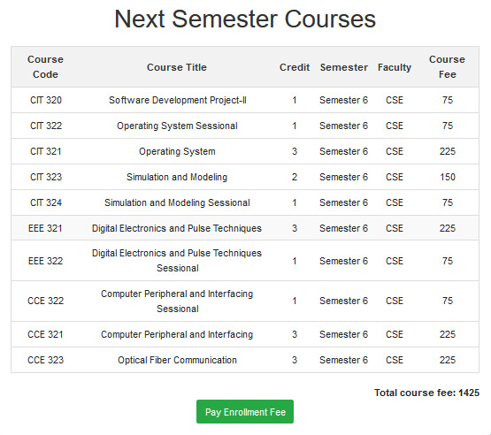
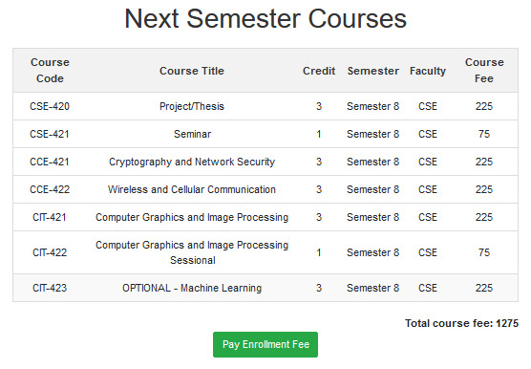
Next Semester Course List

Slide 14
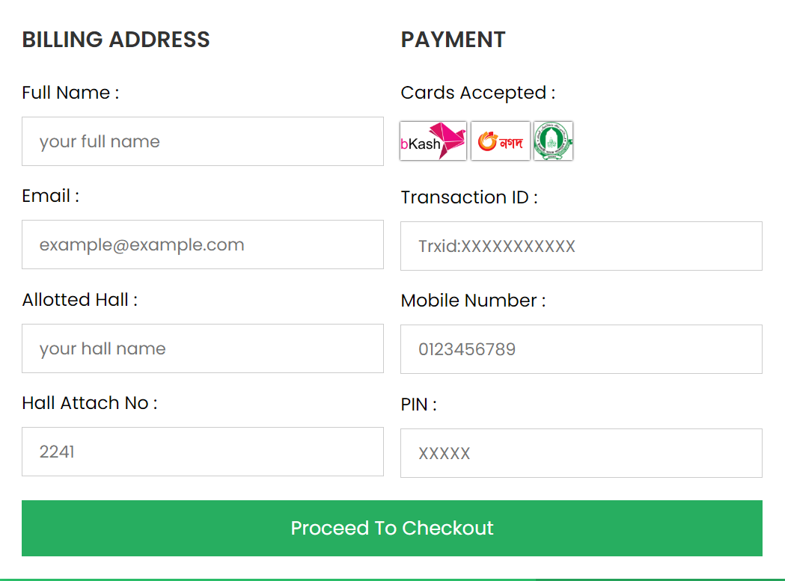
Payment Page Design

Slide 15
Future Work
1
Payment Gateway Integration
Implementation of a secure payment gateway for online transactions.
2
Transaction History Feature
Introduction of a feature to track financial activities and ensure transparency.
3
OTP Verification for Student Logins
Enhancement of security measures using one-time password verification.
4
Optimal Hosting Solutions Exploration
Research and implementation of hosting options for system performance.
5
New User Role for Faculty Administrators
Introduction of a tailored user role to meet unique administrative needs.

Slide 16

Thank You for Staying with Us

